Slide 1
YARN Preparation
Md Afroz Afzal
Lecturer, Textile Engineering
Govt. Polytechnic, Patna-7

Slide 2
Introduction
WINDING
WARPING
SIZING
DRAWING-IN

Slide 3
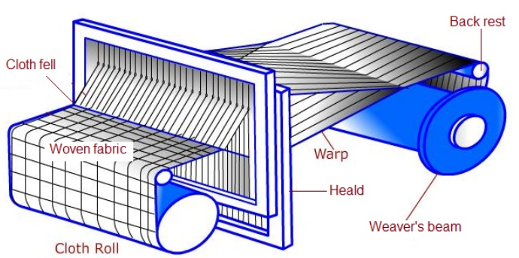
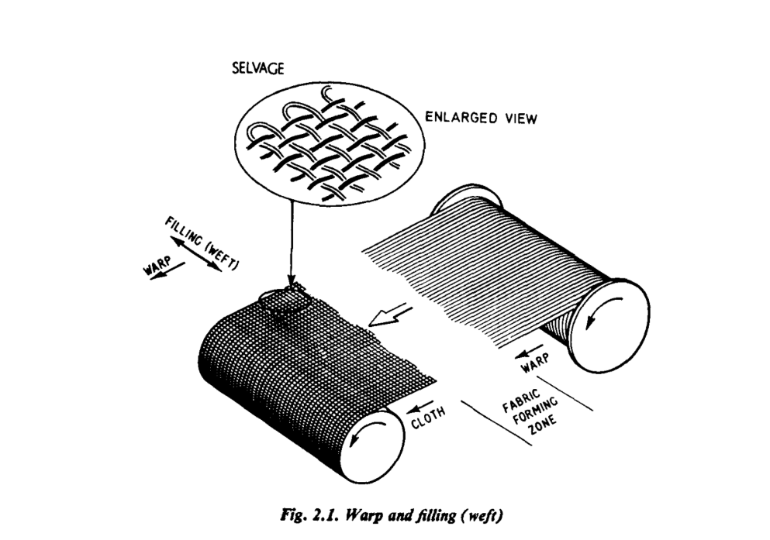
weaving
Weaving : It is the process of interlacement of warp with weft
Warp : Longitudinal yarn in the fabric is called warp
Weft : Lateral/Crosswise yarn in the fabric is called weft

Slide 4
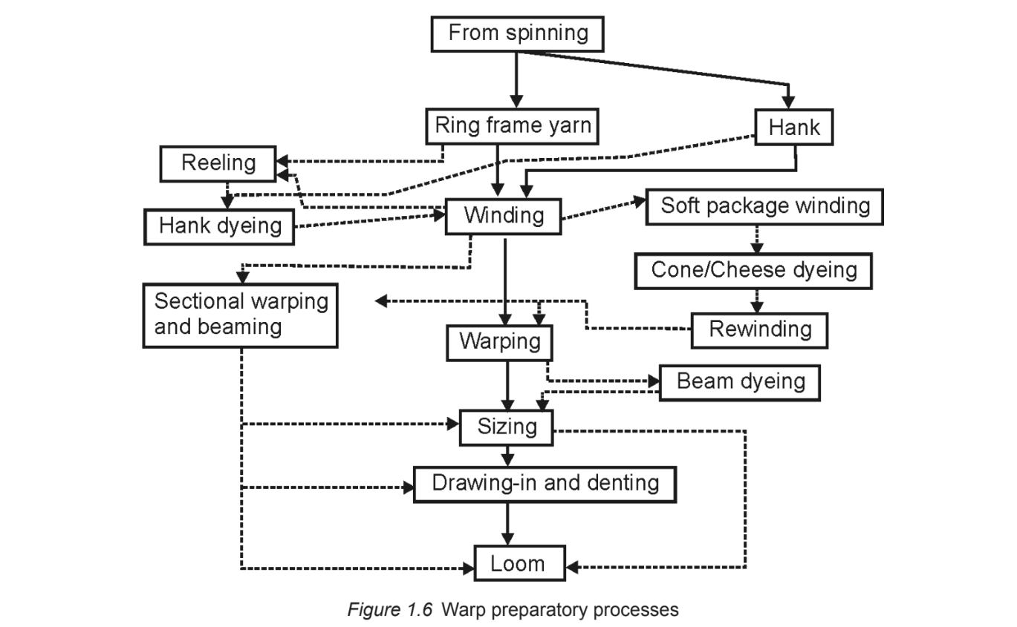
warp preparation for weaving

Slide 5
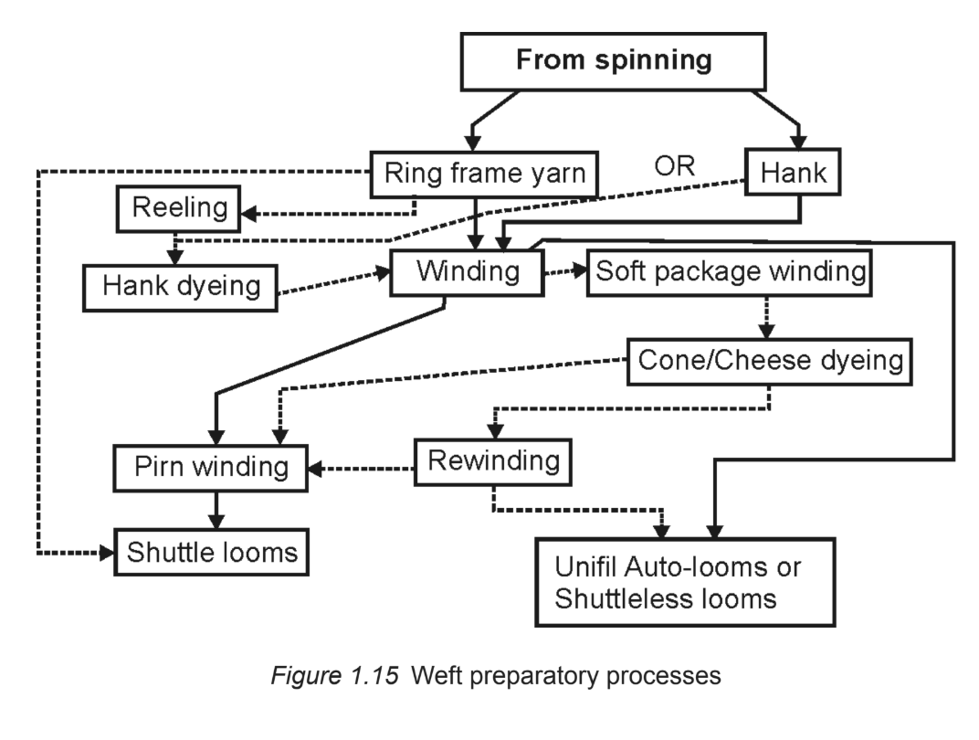
weft preparation for weaving

Slide 6
WINDING
Objectives:-
Removing objectionable faults
Converts smaller ringframe package to bigger package i.e, Cheese & Cone
Keeping safe the yarn surface during winding process

Slide 7
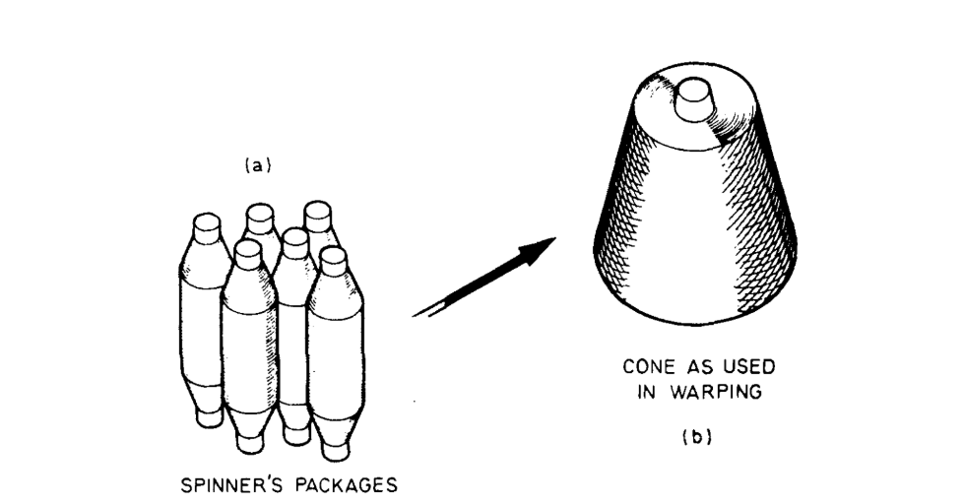
WINDING
From left to right: Ringframe bobbin or cop, Cone, Cheese and Pirn

Slide 8
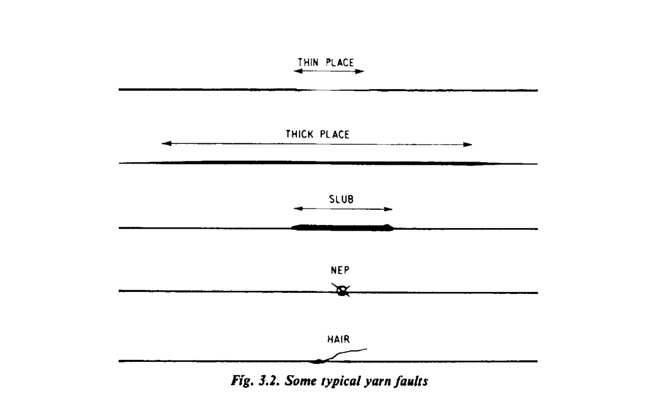
Objectionable faults

Slide 9
Basics of package building
Two basic motions are required for effective winding :-
First, the rotational motion of the package, on which the yarn is being wound
Second, the traverse motion is requited so that the entire width of the package is used for winding

Slide 10
Types of Wound Packages
Parallel wound package
Nearly parallel wound package
Cross wound package

Slide 11
Parallel wound package

Slide 12
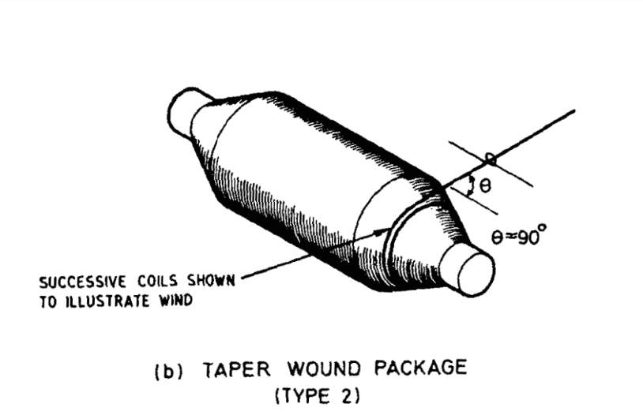
Nearly parallel wound package

Slide 13
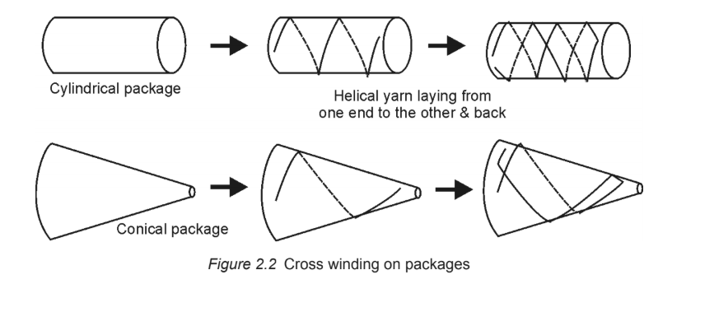
Cross wound package

Slide 14
Important Definitions in Winding
Wind:
It is the number of revolutions made by the package (i.e. number of coils wound on the package) during the time taken by the yarn guide to make a traverse in one direction (say from left to right) across the package.
Traverse ratio or wind ratio or wind per double traverse:
It is the number of revolutions made by the package (i.e. number of coils wound on the package) during the time taken by the yarn guide to make a to and fro traverse. This to and fro traverses of the yarn guide from left to right and back from right to left is known as double traverse.
Traverse ratio= 2× Wind
Cont…..

Slide 15
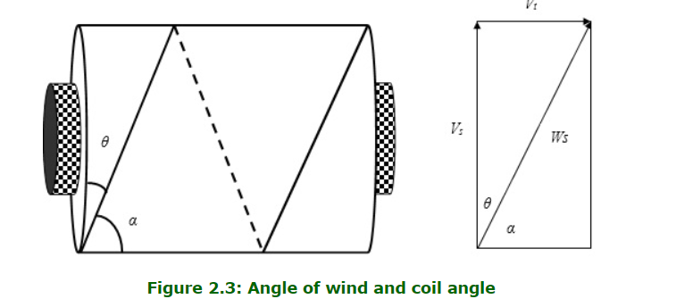
Important Definitions in Winding
Angle of wind ( θ ) :
It is the angle made by the yarn with the sides of the package (Figure 2.3). If surface and traverse speeds are V_{s} and V_{t} respectively, then
Cont…..

Slide 16
Important Definitions in Winding
Coil angle ( α ) :
It is the angle made by the yarn with the axis of the package (Figure 2.3). The coil angle and angle of wind are complementary angles as they add up to 90°.
The net winding speed can be obtained by the resultant vector of surface speed (Vs) and traverse speed (Vt ).

Slide 17
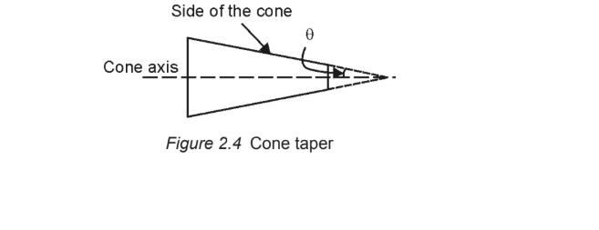
Important Definitions in Winding
Taper of cone :
The conicity or the taper of cone is the angle between the central axis of the cone and the tapered face. Cone taper generally ranges between 0° (cylindrical package) and 9° 15 '.
The following angle of tapers are recommended for different purposes:
2° - Shuttleless weaving
3° 30 ' - Continuous filament pineapple cones
4° 20 ' - Cones for warping
9° 15 ' / 9° 30 ' - Hosiery yarn for knitting

Slide 18
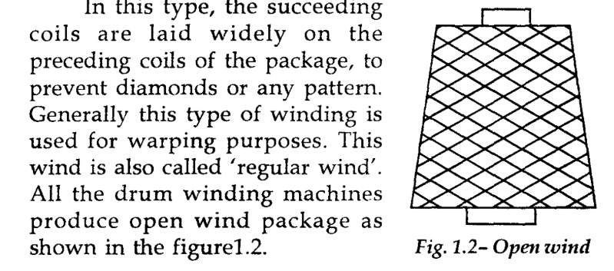
Types of winds in cone/cheese winding
Open wind
Cont…

Slide 19
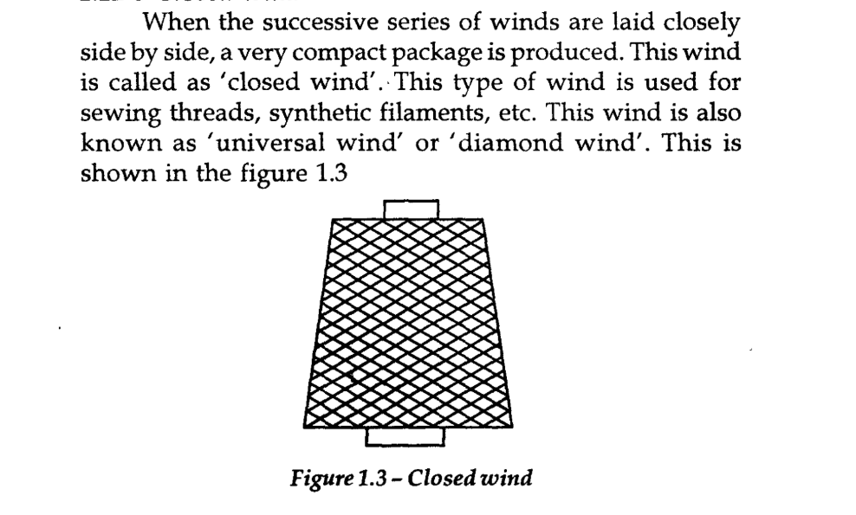
Types of winds in cone/cheese winding
Closed wind

Slide 20
Classification of winding machine
On the basis of winding principles
(1) Drum driven or random winders
(2) Spindle driven or precision winders
On the basis of package type
(1) Cope winding machines
(2) Cone winding machines
(3) Cheese winding machines
(4) Flanged bobbin winding machines
(5) Pirn winding machines
On the basis of package drive
(1) Direct drive winding machines
(2) Indirect drive winding machines
Cont….

Slide 21
Classification of winding machine
On the basis of yarn type
(1) Warp yarn winding machines
(i) Upright spindle winding machine
(ii) Drum winding machine
(2) Weft yarn winding machines
(i) Pirn winding machines
(a) Ordinary pirn winding machines
(b) Automatic pirn winding machines
(ii) Cope winding machines

Slide 22
Drum driven or random winding
Cont……

Slide 23
Drum driven or random winding
Cont……

Slide 24
Drum driven or random winding
Cont……

Slide 25
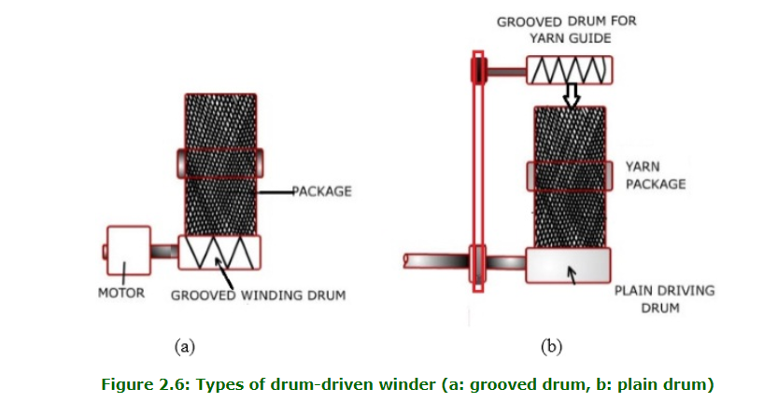
Drum driven or random winding
Cont……

Slide 26
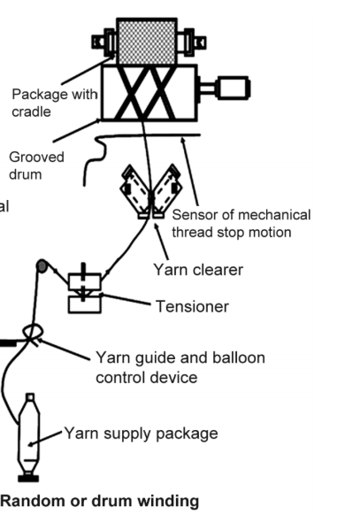
Passage of material on random winding machine
Cont……

Slide 27
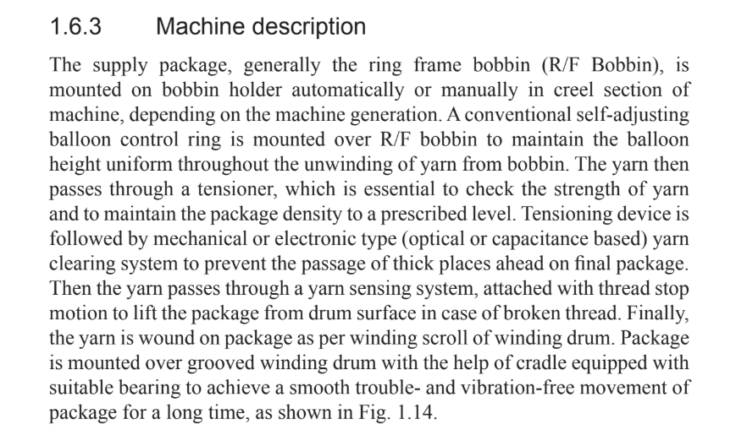
Machine Description
Cont……

Slide 28
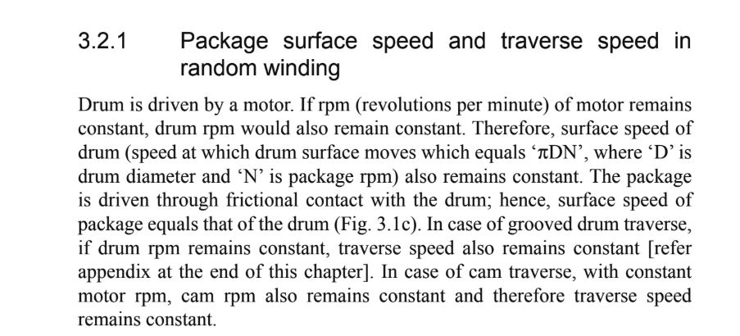
Characteristics of Drum winding
Cont….

Slide 29
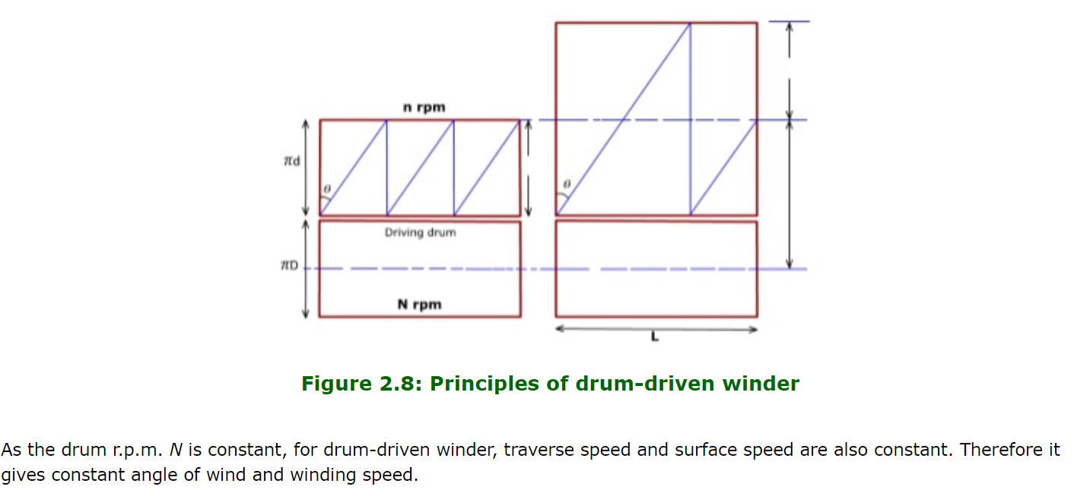
Characteristics of Drum winding
Cont….

Slide 30
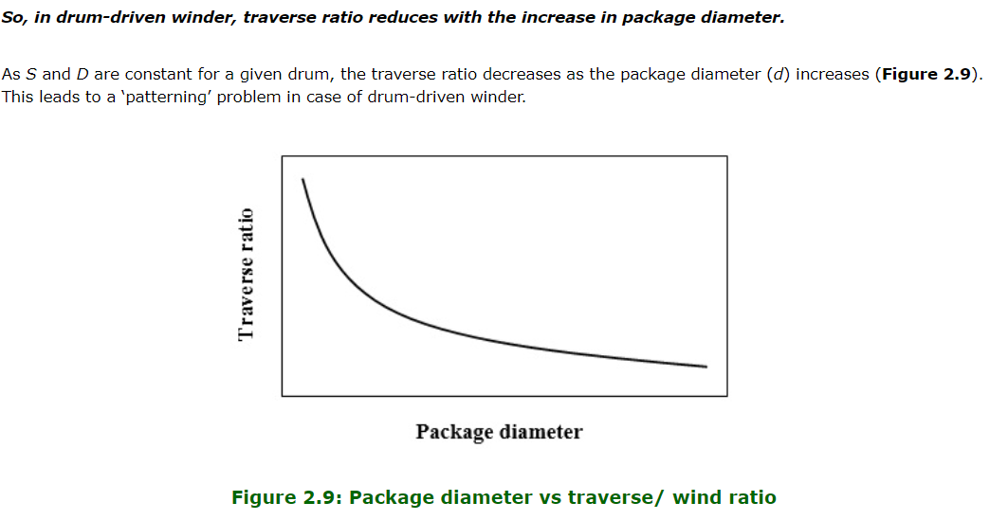
Characteristics of drum winding
Cont….

Slide 31
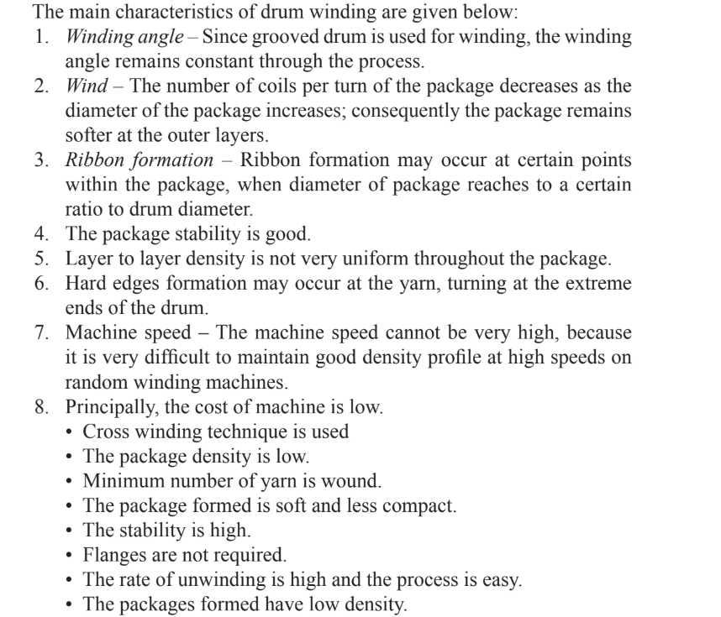
Characteristics of random winding

Slide 32
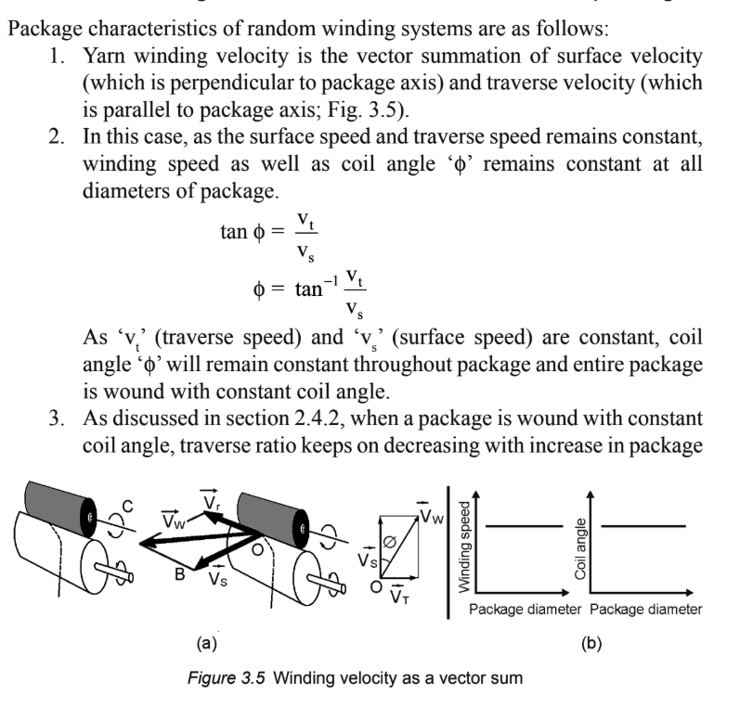
Package Characteristics of random winding
Cont…

Slide 33
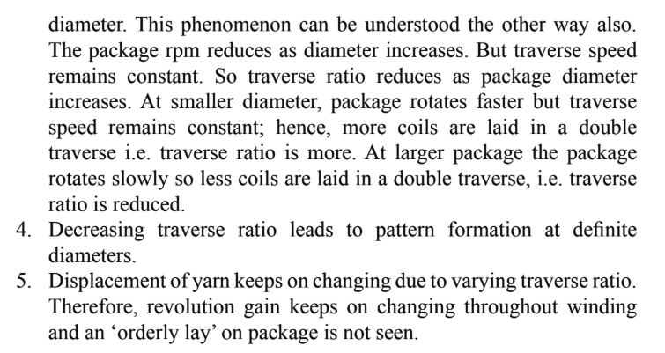
Package Characteristics of random winding
Cont…

Slide 34
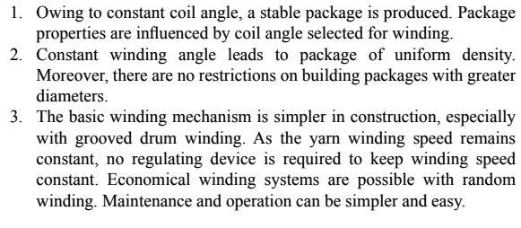
Merits and demerits of random winding
Merits

Slide 35
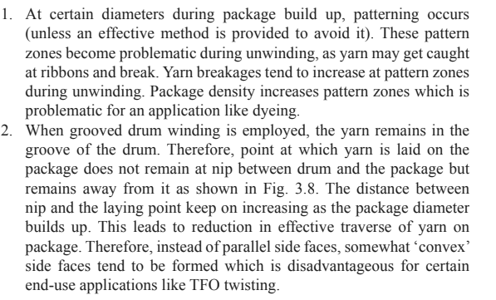
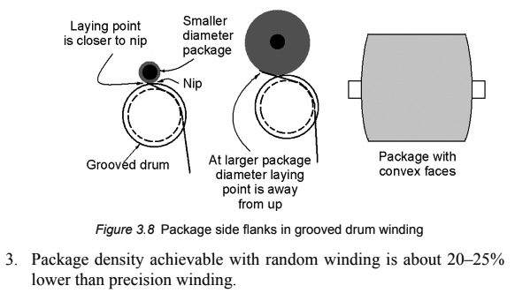
Merits and demerits of random winding
Demerits

Slide 36
Patterning or ribbon
If the traverse ratio (wind per double traverse) value is an integer, then the yarn comes back to the same position on the package surface after one double traverse. This happens because the diameter of the yarn is minuscule and thus one double traverse does not cause significant increase in package diameter. Therefore, in the next double traverse, the yarn is laid just over the yarn which was laid in the previous double traverse. As a result, a ribbon develops in the package. This problem is known as patterning problem.
In case of drum-driven winders, the traverse ratio value reduces with the increase of package diameter. When, the value becomes integer, the package becomes susceptible to patterning.
Cont…

Slide 37
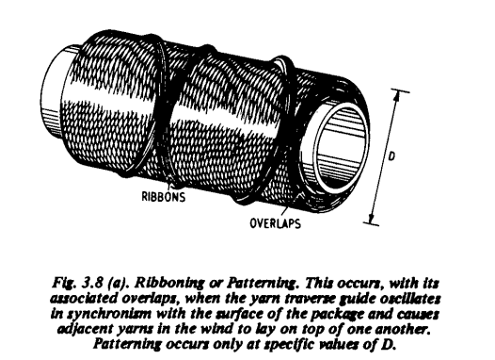
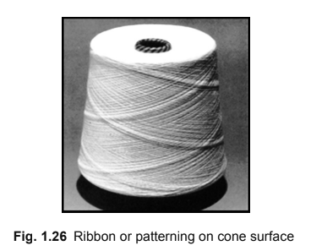
Patterning or ribbon

Slide 38
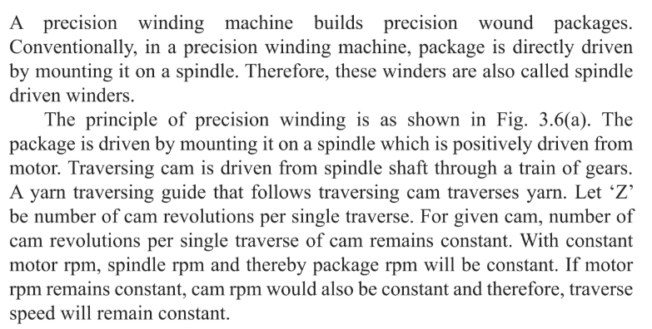
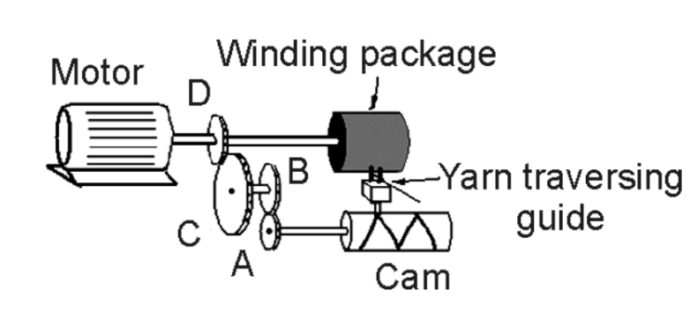
Spindle driven or Precision Winding
Cont…

Slide 39
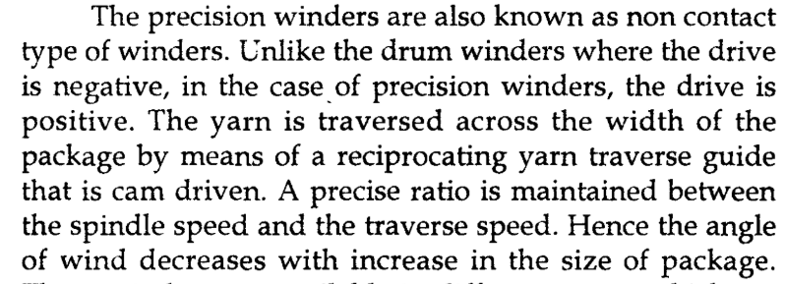
Precision Winding

Slide 40
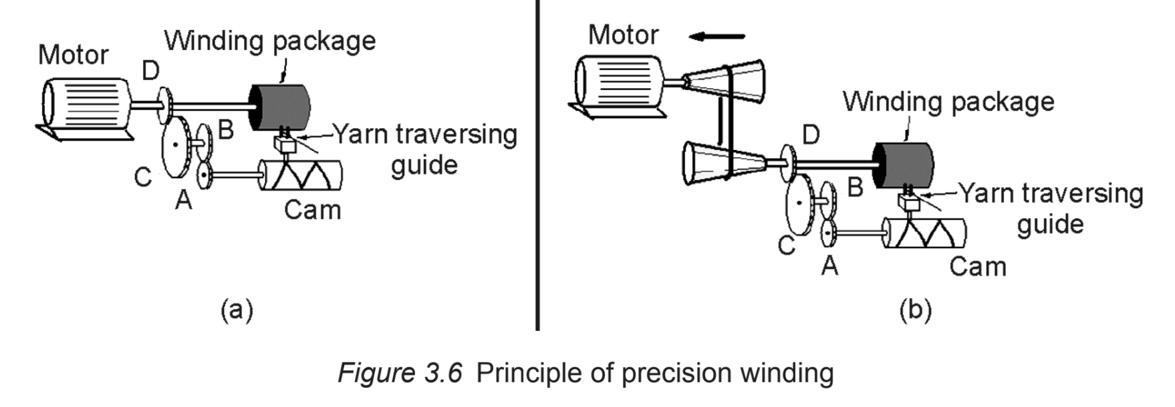
types of Precision Winding
Cont…

Slide 41
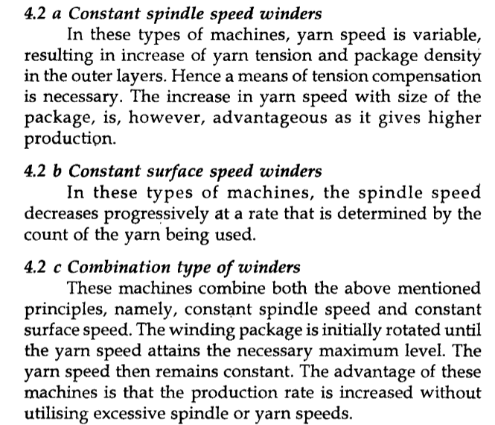
types of Precision Winding
Cont…

Slide 42
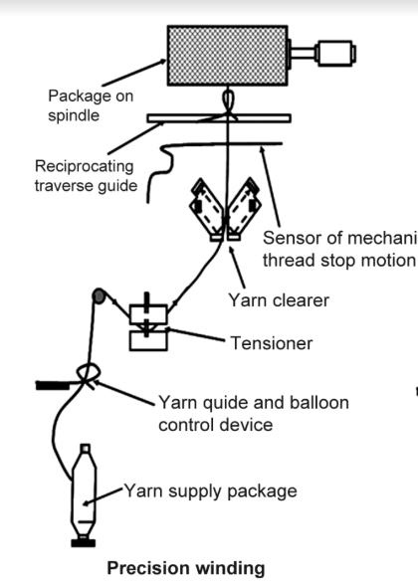
Passage of material on precision winding machine
Cont….

Slide 43
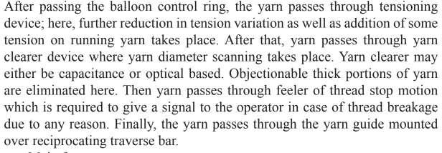
Machine description

Slide 44
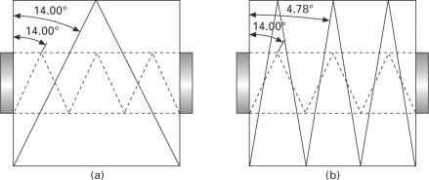
Characteristics of precision winding
Random Winding
Precision winding

Slide 45
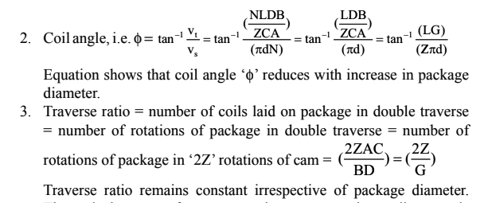
Package characteristics of precision winding

Slide 46
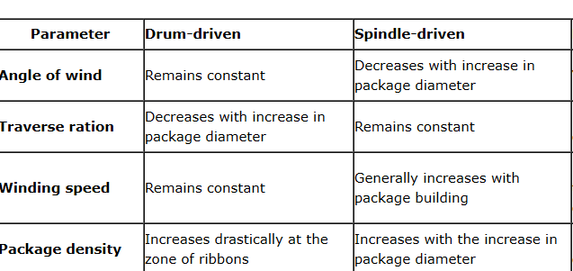
Comparison matrix of winding principle

Slide 47
Merits and demerits of precision winding
Merits

Slide 48
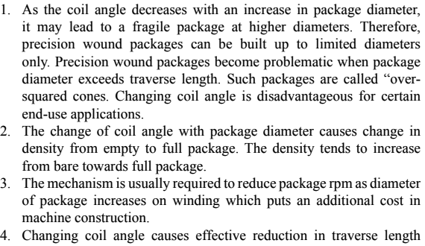
Merits and demerits of precision winding
Demerits

Slide 49
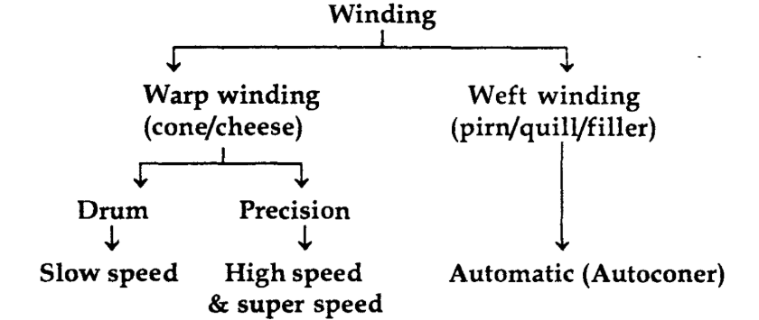
Slow speed, high speed & super speed winding
Cont…

Slide 50
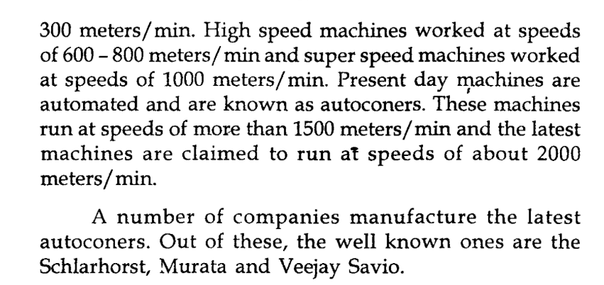
Slow speed, high speed & super speed winding

Slide 51
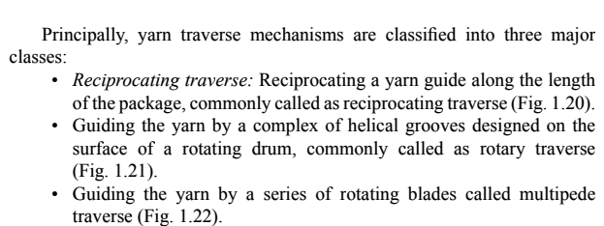
Yarn traverse

Slide 52
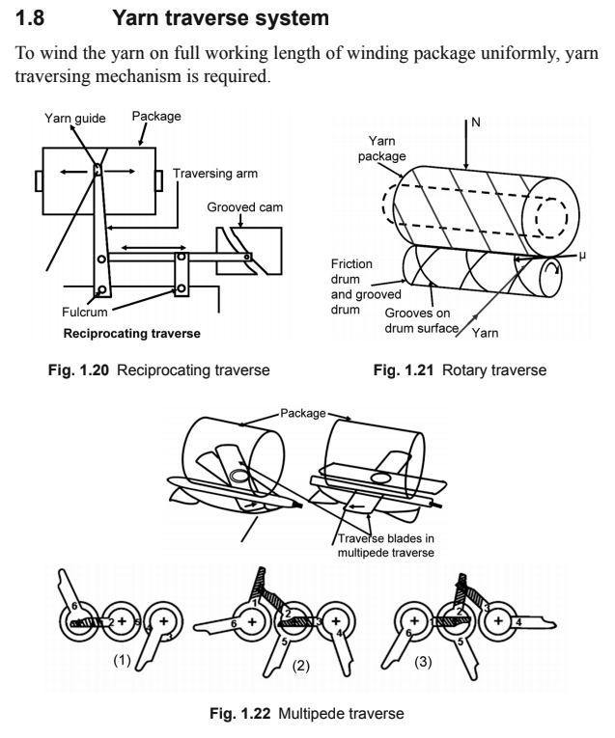
Yarn traverse

Slide 53
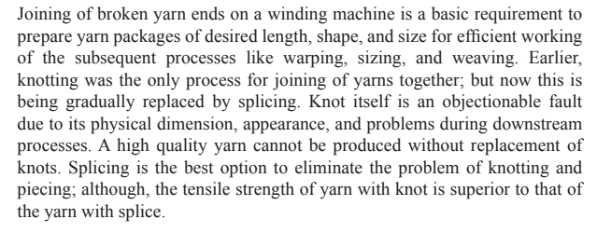
Knotting and splicing

Slide 54
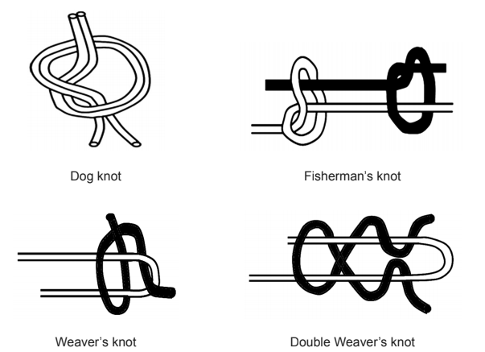
Knotting

Slide 55
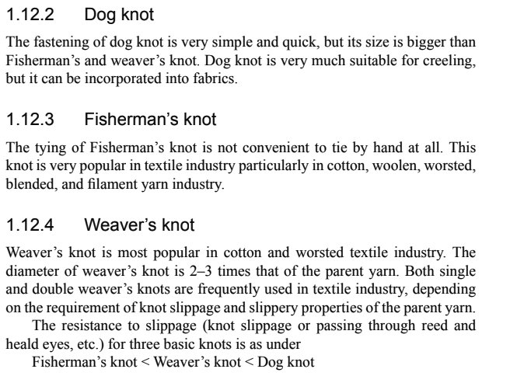
Types of knot

Slide 56
Knotting efficiency

Slide 57
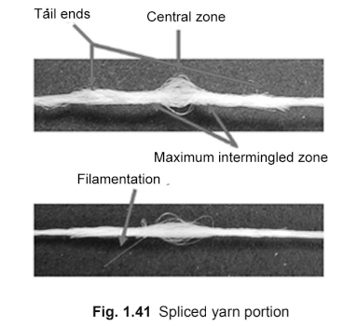
Splicing

Slide 58
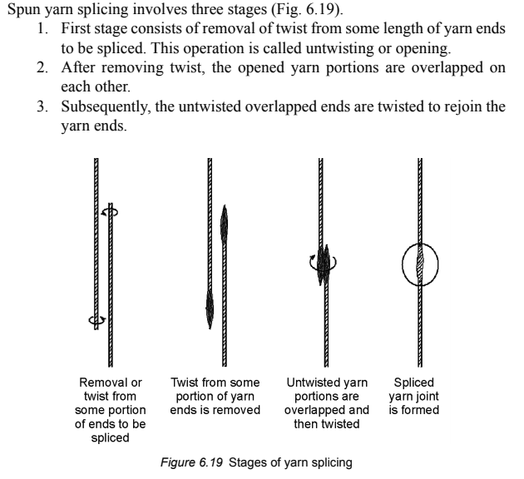
Stages of yarn Splicing

Slide 59
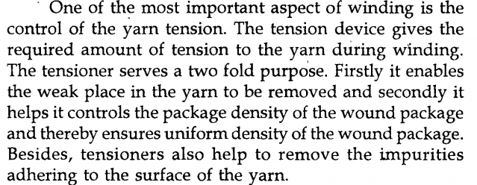
tensioner
Cont….

Slide 60
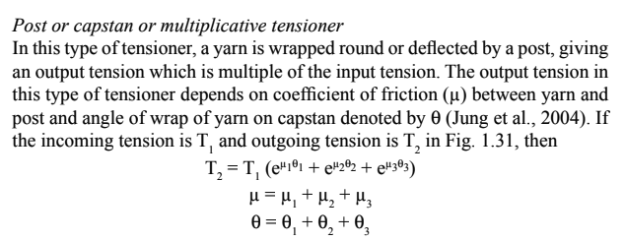
Capstan tensioner

Slide 61
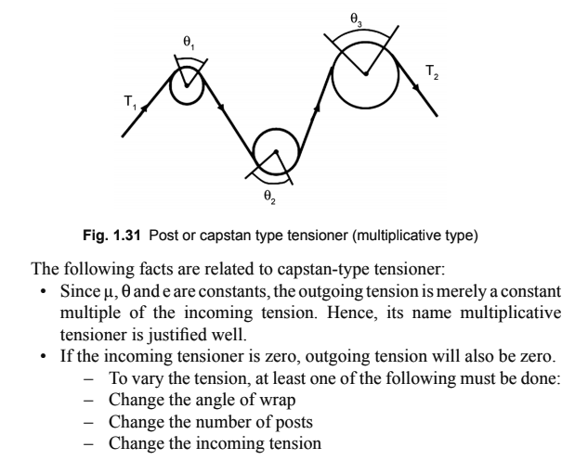
Capstan tensioner

Slide 62
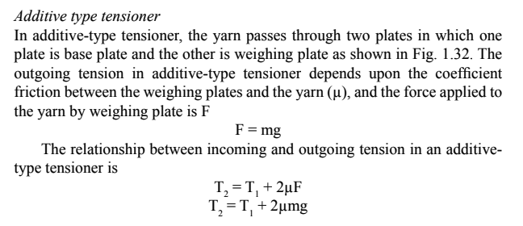
additive tensioner

Slide 63
combined tensioner

Slide 64
Yarn clearers

Slide 65
Mechanical Yarn clearers

Slide 66
Mechanical Yarn clearers

Slide 67
electronic Yarn clearers
Electronic yarn clearers detect yarn faults using electronic principles and therefore are capable of eliminating a wider spectrum of yarn faults very efficiently.
Capacitance type electronic yarn clearer
Optical type electronic yarn clearer

Slide 68
Capacitance type Yarn clearers

Slide 69
optical type Yarn clearers

Slide 70
Yarn clearing efficiency of slub catchers

Slide 71
Wound package defects

Slide 72
Wound package defects

Slide 73
Wound package defects

Slide 74
Wound package defects

Slide 75
Wound package defects

Slide 76
Wound package defects

Slide 77
Wound package defects

Slide 78
references
Weaving Preparation Technology by Dr. N.Gokarneshan
Fundamentals of Yarn Winding by Milind Koranne
Industrial Practices in Weaving Preparatory by Dr. Mukesh Kumar Singh
Fabric Manufacturing-I, NPTEL, IITD

